Slide 1
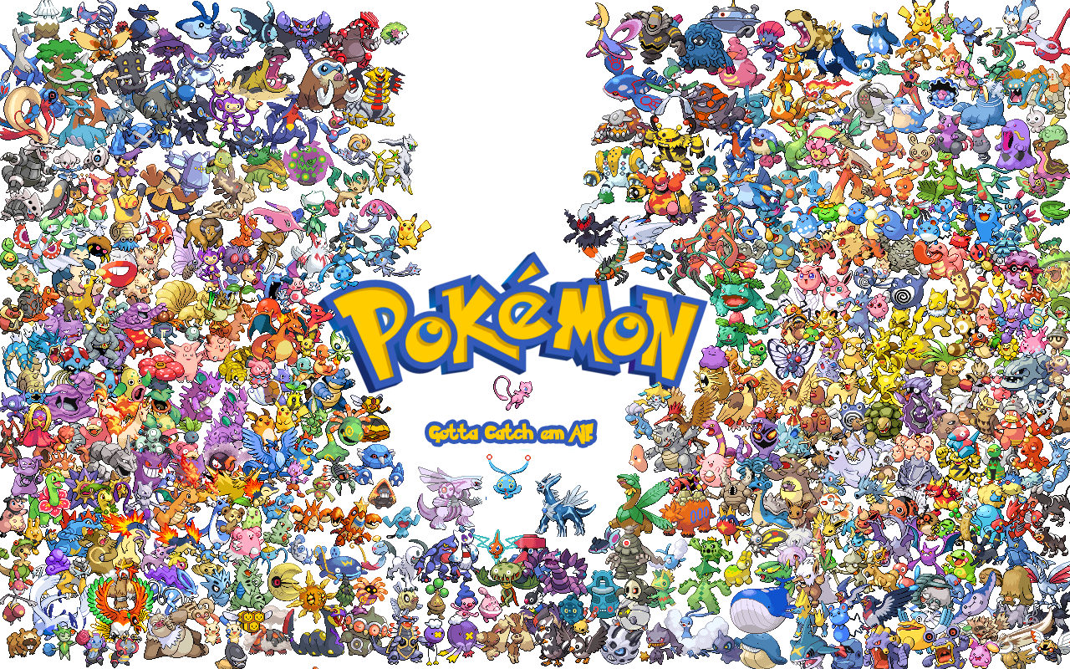
By:
Alex Morsey
Bryce Baker
Gregg McMillion

Slide 2

We created the Pokemon Menu Displaying:
Pokedex
Pokemon Party
Items
Badges

Slide 3
Each menu option using various techniques we’ve learned in Data Structures such as:
Binary Trees
Queues
Bubble Sort
Selection Sort
Stacks
Hashings

Slide 4
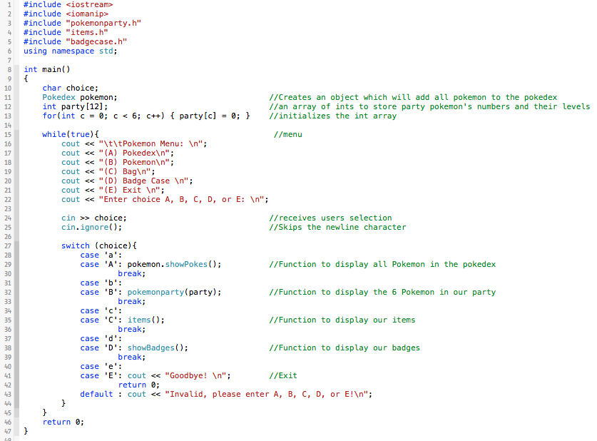
Main.cpp
Uses switch cases to navigate the menu
Each case calls a different function which are located in separate header files.

Slide 5
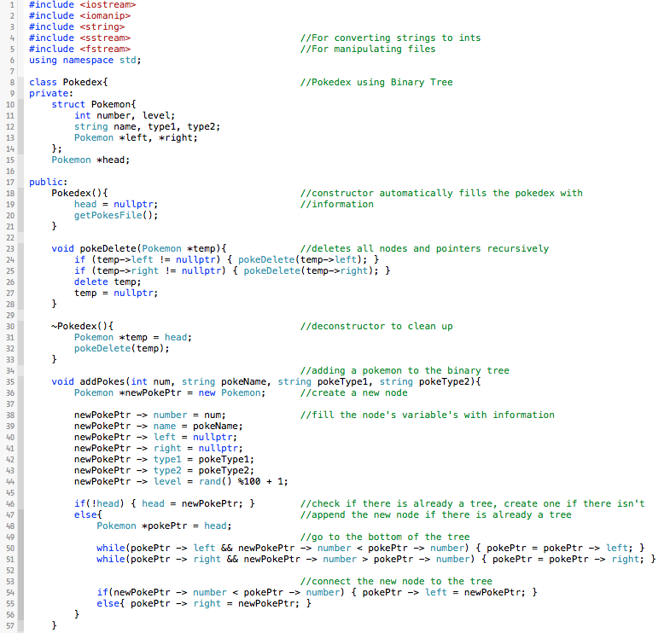
Case A.) Pokedex
When case A is selected, our program builds the pokedex using a binary tree
It will grab the name of each 151 Pokemon from a txt file we have, and add them to the binary tree

Slide 6
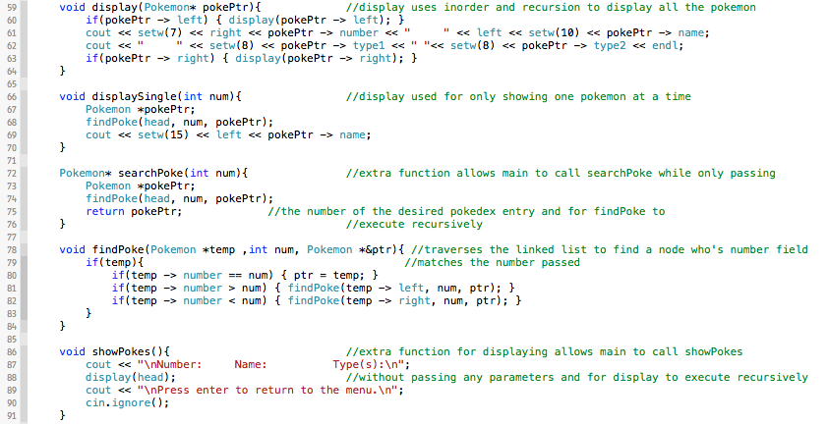
Case A.) Pokedex
This is a continuation of the Pokedex file where it displays pokemon.

Slide 7
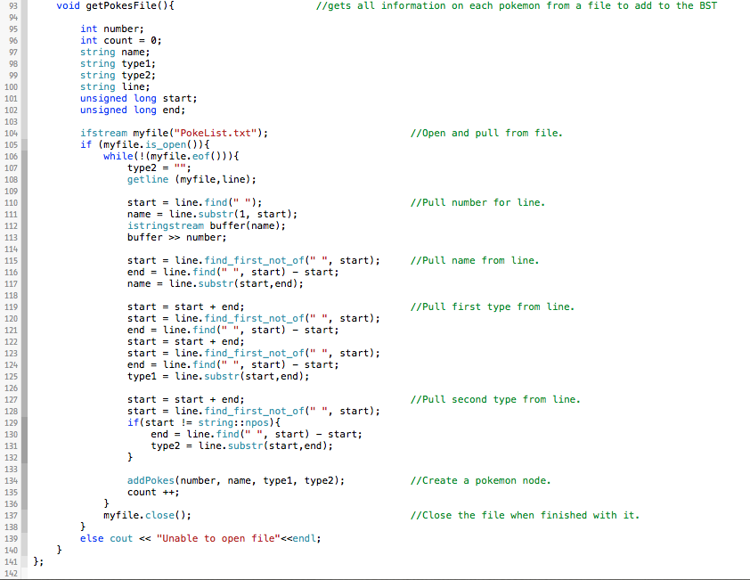
Case A.) Pokedex
This is our function which gets all information from the txt file.

Slide 8
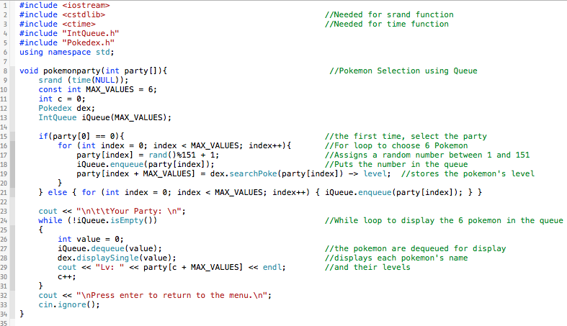
Case B.) Pokemon Party
When we choose case B, pokemon party function will be called which randomly selects 6 Pokemon for our party. Also uses queue’s.

Slide 9
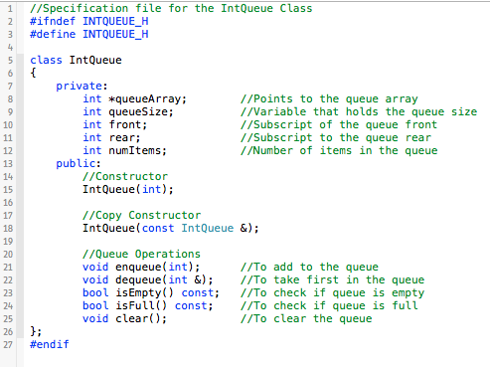
Case B.) Pokemon Party
Queue class and its funtions

Slide 10
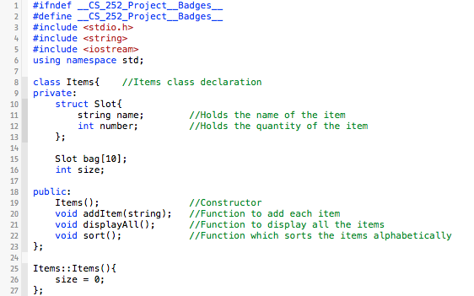
Case C.) Bag
Items class and its funtions

Slide 11
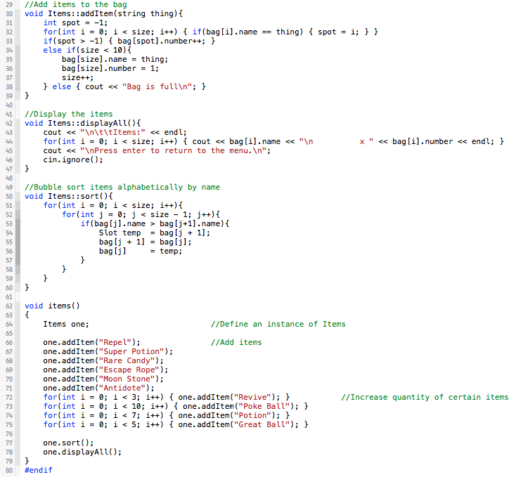
Case C.) Bag
The implementation of the functions used in the items class.
Last function adds items and the quantity to some items.

Slide 12
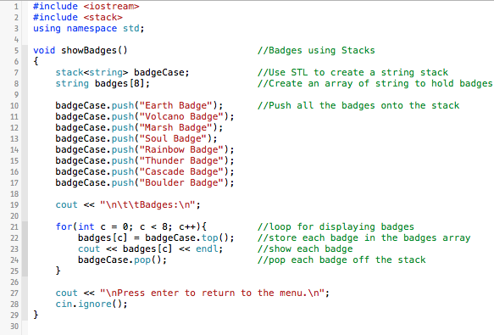
Case D.) Badges
When case D is picked, our show badges function is called which builds a stack for our Pokemon Badges

Slide 13


